Slide 1
Union of the Buffer Cache and Journaling Layers with Non-volatile Memory
Eunji Lee (Ewha University, Seoul, Korea)
Hyokyung Bahn (Ewha University)
Sam H. Noh (Hongik University)
USENIX FAST’13

Slide 2
Outline
Introduction & Montivation
Reliability issues in storage systems
Non-volatile memory as s solution
Design
UBJ: Union of Buffer cache and Journaling
Evaluation
Conclusion

Slide 3
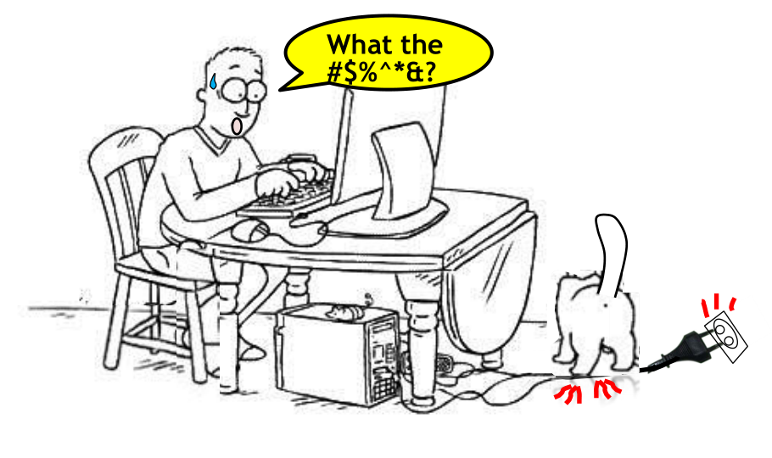
Reliability issues in storage systems

Slide 4
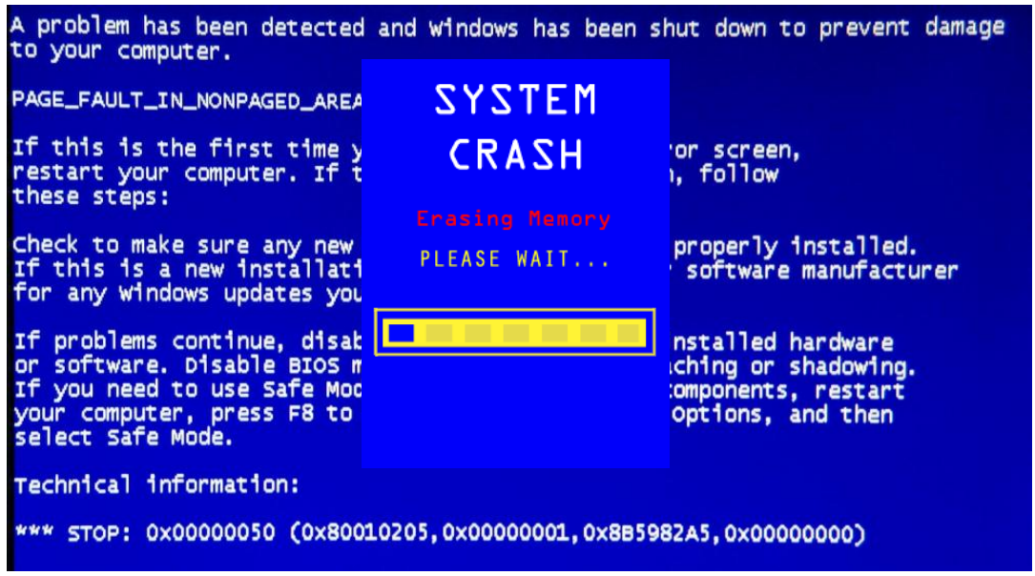
Reliability issues in storage systems

Slide 5
Reliability issues in storage systems
Sudden power failure incurs file system inconsistency
Buffer Cache
E
W
A
S
T
E
Volatile
Non-volatile
After reboot
G
O
W
T
E
A
S
File System
Inconsistent

Slide 6
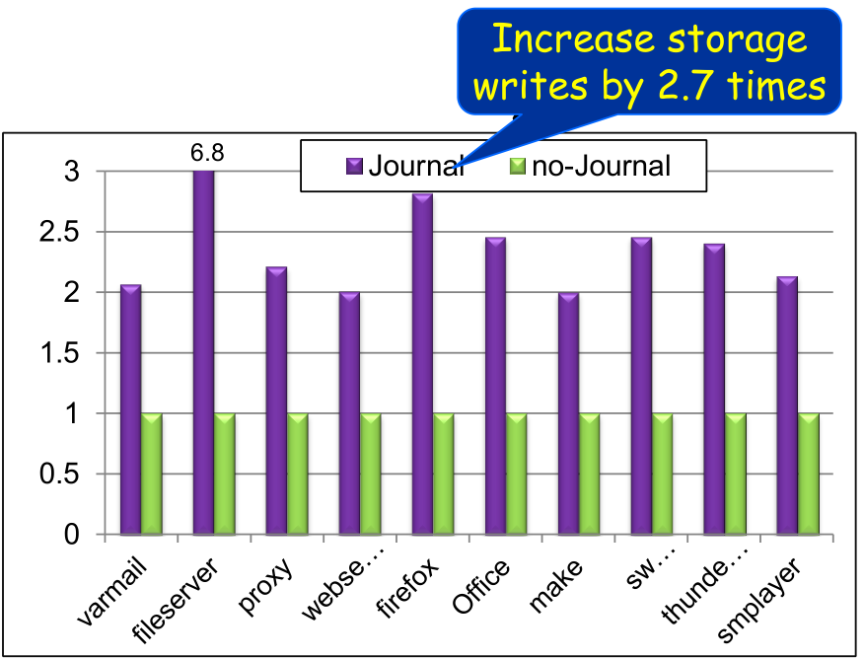
Journaling as a solution
Prevent data inconsistency through write-twice
ext4, ReiserFS, XFS, btrFS …
Buffer Cache
E
W
A
S
T
E
Commit
Journal Area
W
E
Checkpoint
File System
G
O
E
A
S
T
W
E

Slide 7
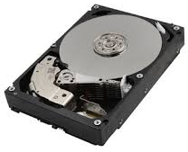
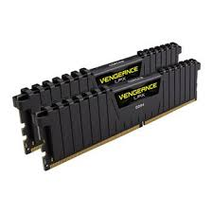
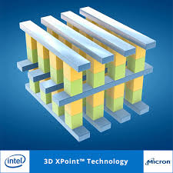

Non-volatile memory as a solution
Characteristics of NVM
HDD/SSD
Persistent but slow
DRAM
Fast but volatile
NVM
Fast and non-volatile

Slide 8
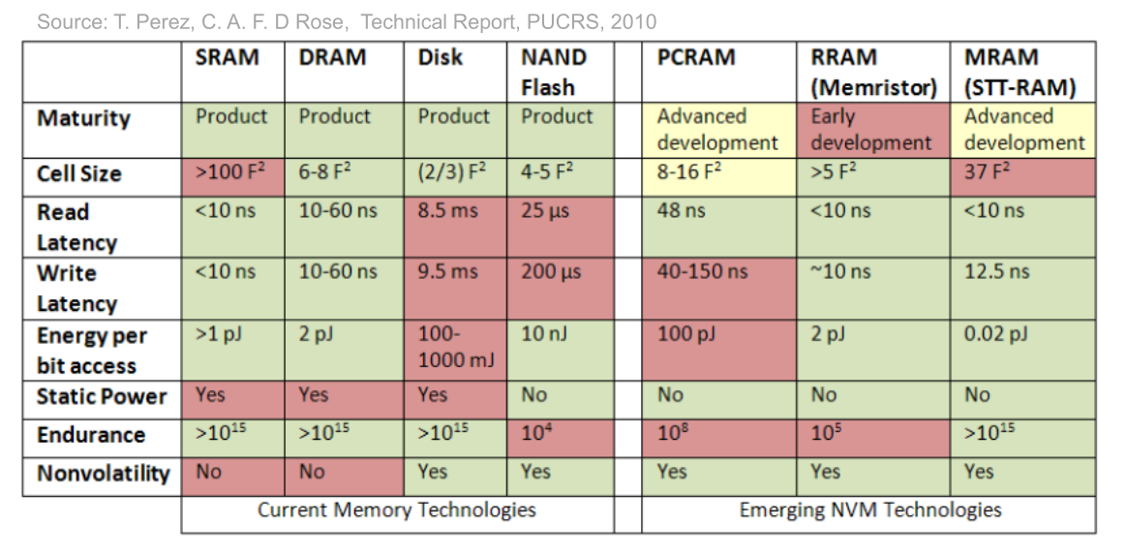
Non-volatile memory as a solution
Characteristics of NVM
Byte-addressable
High performance
Durability

Slide 9
Non-volatile memory as a solution
Replace volatile buffer cache with NVM
NVM
Buffer Cache
DRAM
Volatile
Non-volatile
Journal Area
File System

Slide 10
Non-volatile memory as a solution
Which one to use?
Buffer Cache
E
W
A
S
T
E
Volatile
Non-volatile
G
W
T
G
O
E
A
S
File System
Drop-in replacement of non-volatile memory does not suffice

Slide 11
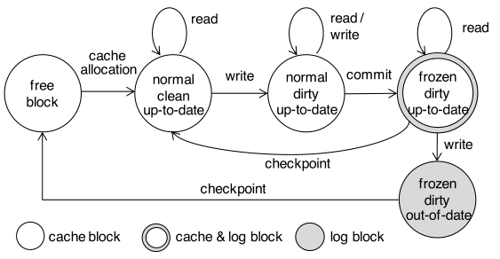
Union of Buffer cache and Journaling Layers (UBJ)
Provide data consistency without sacrificing performance
Design a novel buffer cache architecture “UBJ”
Subsume functions of caching and journaling
Use data block for dual purposes
Provide journaling effect through transition of cache block state

Slide 12

Union of Buffer cache and Journaling Layers (UBJ)
write
commit
checkpoint
clean buffer
dirty buffer
frozen buffer
write
write
write
write
30
60
90
120
Time(s)
D0
D1
D1
D1
D2
D3
D3
D3
D3
D3
D4
D4
commit to storage
commit to storage
checkpoint to storage
original buffer cache with journaling

Slide 13
Union of Buffer cache and Journaling Layers (UBJ)
write
commit
checkpoint
clean buffer
dirty buffer
frozen buffer
write
write
write
write
30
60
90
120
Time(s)
D0
D1
D1
D1
D1
D1
D1
D1
D1
free
free
free
may be freed
commit in-place
D2
D3
D3
D3
D3
D3
D4
D4
commit in-place
checkpoint to storage
UBJ design

Slide 14
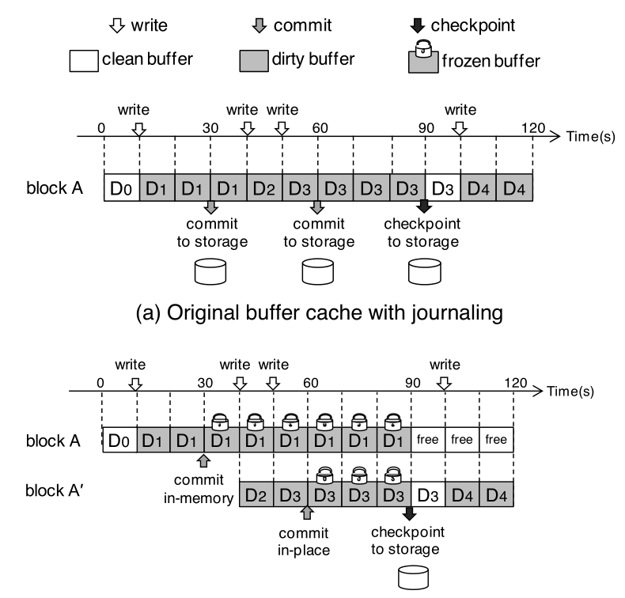
Union of Buffer cache and Journaling Layers (UBJ)
3 disk operations
1 disk operation

Slide 15
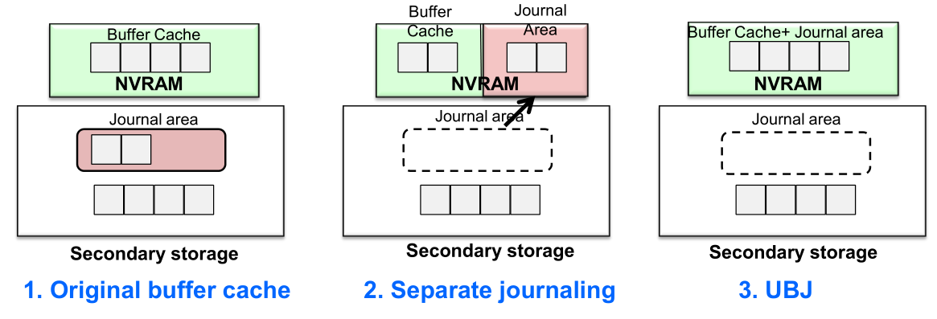
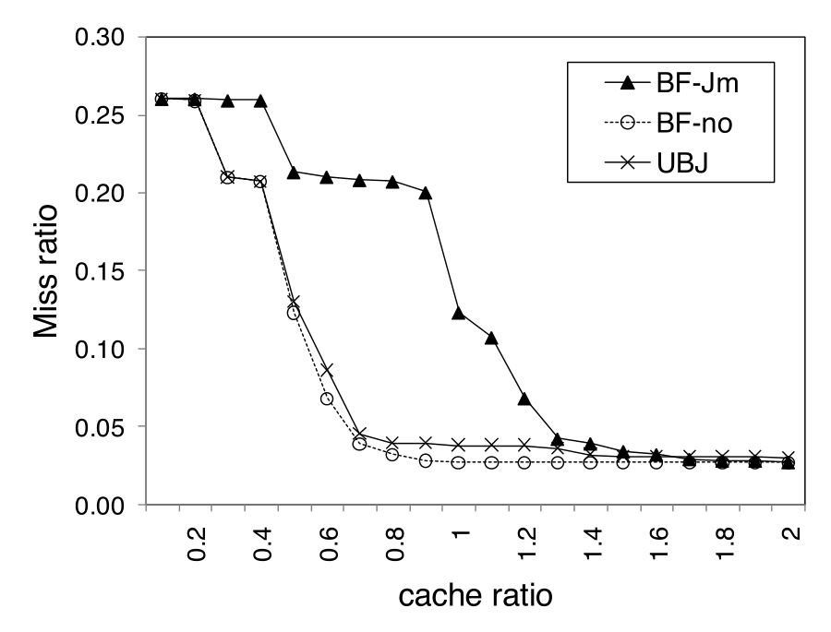
Cache performance of UBJ
UBJ provides nearly same cache performance as original buffer cache

Slide 16
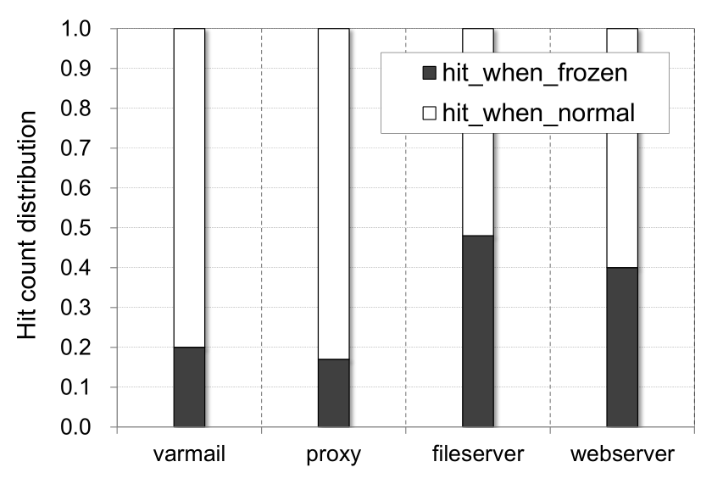
Cache performance of UBJ
16%~48% of cache hits occur in frozen journal area

Slide 17
Performance Evaluation
Prototype of UBJ on Linux 2.6.38
Intel Core i3-2100 CPU
3.1GHz and 4GB of DDR2-800 memory
Emulate non-volatile memory with DRAM
Compare with ext4 in journal-mode
logs both data and metadata
Three benchmarks
Filebench, IOzone, Postmark

Slide 18
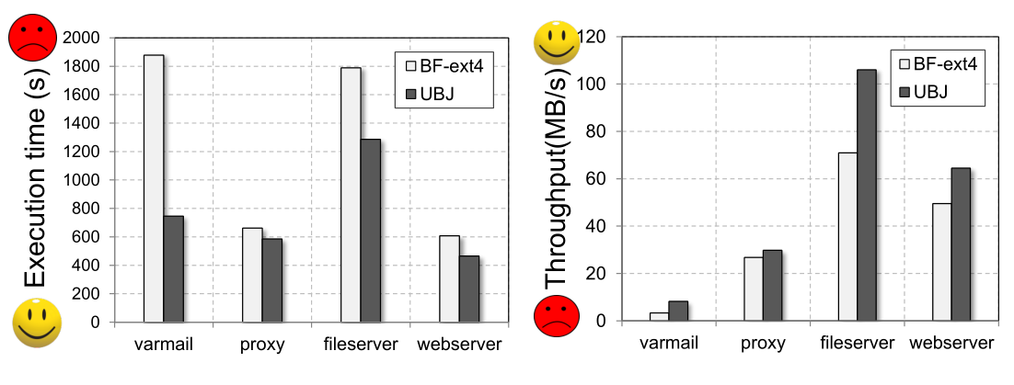
Performance Evaluation
Filebench
Improve execution time and throughput by 30.7% and 59.8% on average
Performance improvement of vamail is the largest due to commit in-place

Slide 19
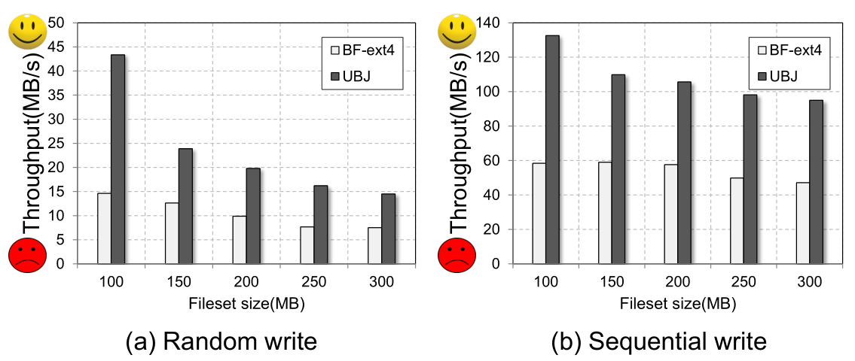
Performance Evaluation
IOzone
Improve performance by 110% on average, up to by 240%
UBJ is more sensitive to fileset size

Slide 20
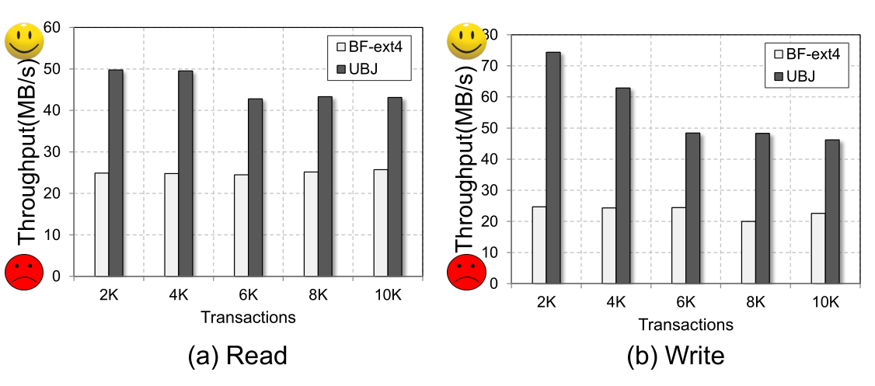
Performance Evaluation
Postmark
Improve performance by 109% on average
Read performance improve because of fewer storage access
More transactions cause more checkpoint and decrease throughput

Slide 21
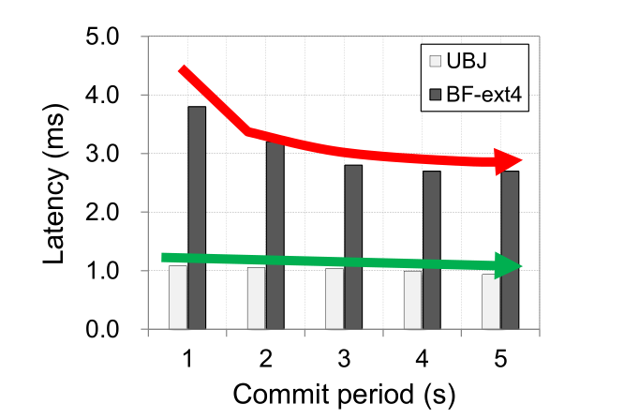
Performance Evaluation
Effectiveness of UBJ on performance as the commit period changes
Latency of ext4 becomes smaller as the commit period is longer
Latency of UBJ is not sensitive to the commit period changes

Slide 22
Conclusion
Novel non-volatile memory buffer cache architecture
Subsumes the functions of caching and journaling
Buffer cache blocks ↔ Journal logs
In-place Commit
Notion of a frozen state
Performance results
Implemented on Linux 2.6.38
Compared to ext4 in journal mode
Improve I/O performance by 76% and up to 240%

Slide 23

董本超
IPADS Lab of SJTU

